Slide 1
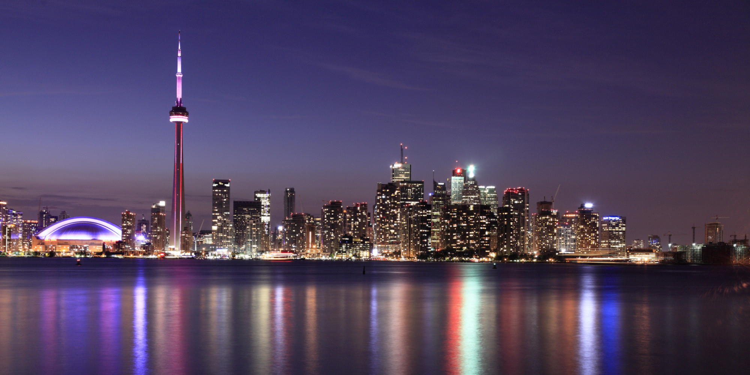
Battle of the Neighborhoods
Part II
By l.sliwinski

Slide 2
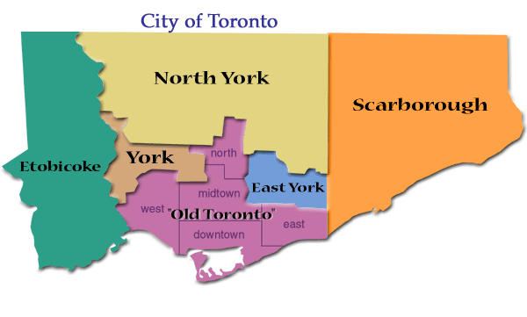
Introduction
The Business Problem that we have outlined is that we would like to know which neighborhoods in Toronto, Ontario, Canada are most conducive to placing a specialty foods store.

Slide 3
Data
I am using Foursquare.com for location data. It outlines the
https://en.wikipedia.org/wiki/List_of_postal_codes_of_Canada:_M

Slide 4
Methodology
My methodology has been to create clusters and sort the Toronto neighborhoods in the absence of their latitudes and longitudes. It has been easiest to classify according to borough and to see what, if any, venues are clustered therein. From there, I have analyzed the density of certain venues and their frequencies. It turns out that the k-clustering algorithm allows you to create a selected number of clusters which can be used to classify the venues in each of the Toronto boroughs.
It is the Toronto neighborhoods with the proper types of venues (restaurants, coffee shops, etc.) and perhaps the correct income characteristics that will receive the green light for the placement of a specialty food shop.

Slide 5
Results
My results have been such that most boroughs are suited to fast food venues, seconded by coffee shops. It appears that pizza places and other venues of similar vein are third common and less common than other venues of a similar nature. I have the result that putting a specialty foods store in boroughs and preferably in neighborhoods (the smaller-level version of boroughs) where fast food joints are not common is the most logical step, and choosing a borough with coffee shops and similar upscale eateries is a more sound decision. This includes the boroughs of North York, Downtown Toronto, York, Toronto, Queen's park (Toronto), Mississauga, and East Toronto. The places with the least proclivity to place a sound specialty foods store include all of the other boroughs.

Slide 6
Discussion
To discuss any observations that I noted, it is that most boroughs are not suited to the placement of a specialty foods store, and that the boroughs that I noted above are those that are the furthest away and have the least frequency of "cheap" eateries and similar establishments, although all boroughs have street networks as one of their defining features. What is more, most boroughs are not suited towards the placement of a specialty foods store, and those that are are few in number. By means of a k-means clustering algorithm where the number of clusters is 10, I have found out how many neighborhoods in Toronto are conducive to the placement of a specialty foods store.

Slide 7
Conclusion
In conclusion, the neighborhoods in the aforementioned paragraphs are the ones that are most conducive to placing a specialty foods store.

Slide 8
Bibliography
https://www.huffingtonpost.ca/2015/09/19/world-most-expensive-cities-toronto-montreal_n_8161118.html
http://www.rapdict.org/Toronto

